Slide 1
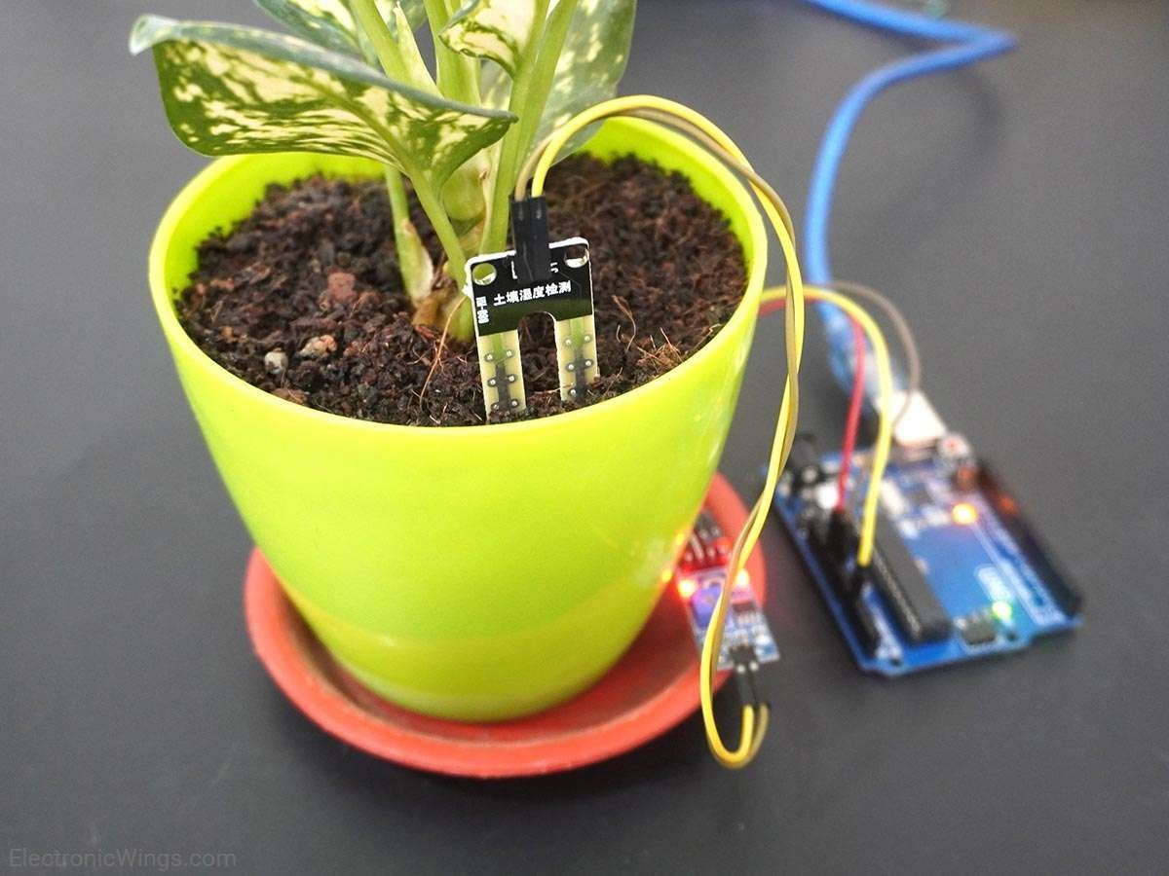
SOIL MOISTURE DETECTOR WITH WATER SUPPLY

Slide 2
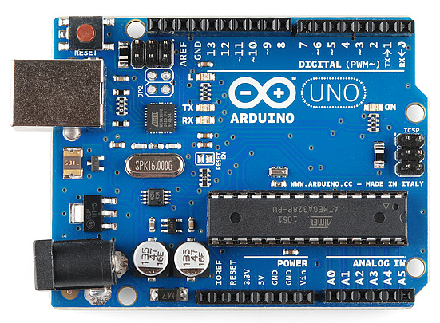
Arduino UNO
The Arduino UNO has different types of pins that you can use to connect sensors, motors, and other parts. These pins can be divided into analog pins and digital pins.
Analog Pins: These pins can read or send continuous signals, like measuring the level of light or temperature. They work with values that can change smoothly (for example, from 0 to 1023), which is useful for things like reading sensors that measure real-world changes.
On the Arduino UNO, there are 6 analog pins, labeled
A0 to A5.
Digital Pins: These pins can only read or send two types of
signals—ON (HIGH) or OFF (LOW/). They are like light
switches that can be turned on or off, making them perfect
for controlling things like LEDs, buttons, or motors.
The Arduino UNO has 14 digital pins, labeled 0 to 13.

Slide 3
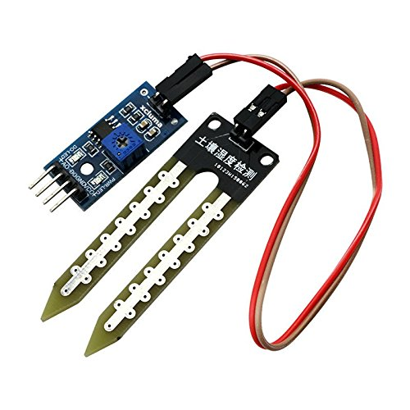
Soil Moisture Sensor
A soil moisture sensor is a device used to measure how much water is in the soil. It tells you if the soil is dry, moist, or wet, which is helpful for farming, gardening, or smart irrigation systems.
A0 – Analog Input
D0 – Digital Input
GND – Ground (acts as
negative terminal)
VCC – Voltage supply
*
* Connect either D0 or A0 while doing project and code accordingly
In this project we connected to A0

Slide 4
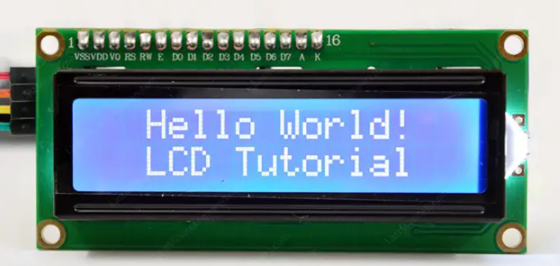
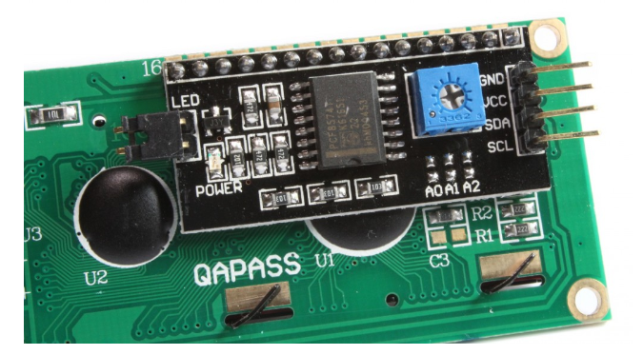
LCD- I2C
Communication
An LCD (Liquid Crystal Display) is a screen that shows letters, numbers, and images using a technology called liquid crystals. It’s commonly used in watches, calculators, TVs, and Arduino projects.
GND – Ground (acts as negative terminal)
VCC – Voltage supply

Slide 5
SDA (Data Line): In technical terms, SDA (Serial Data Line) is the wire in I2C communication that carries the actual information (data) between devices.
It’s like when you tell your friend what you want to draw on a board.
SCL (Clock Line): It is used to synchronize the data transfer between the Arduino (master) and the connected devices (slaves).
Imagine you are playing a game where you and your friend take turns saying numbers, but you only speak when a bell rings. The SCL pin is like the bell that rings to tell you both, "Now it's your turn to speak" It keeps the game organized so no one talks at the wrong time.

Slide 6
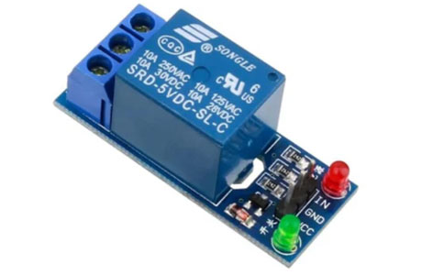
Relay Motor
A relay is an electrically operated switch used to control a high-power circuit with a low-power signal. It consists of an electromagnet (coil), a movable armature, and one or more sets of contacts.
A relay is like a magic switch that controls big machines (like motors) using tiny signals from a controller (like Arduino)
IN – Connecting to either
Digital or Analog Pin
GND – Ground (acts as
negative terminal)
VCC – Voltage supply
It has three main points to understand: NC, NO, and C.

Slide 7
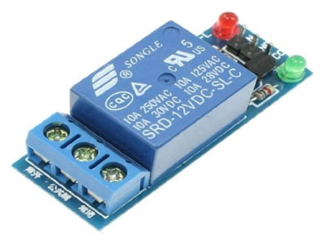
The relay is like a bridge that cars (electricity) need to cross to reach the motor.
There are two possible paths for the cars to take:
One is always open (NO – Normally Open).
One is always closed (NC – Normally Closed).
C (Common)
Think of this as the starting point for all cars. It’s where electricity begins.
It’s one of the main connection points where electricity enters or exits the relay
NC (Normally Closed)
This is the default road. If no one tells the bridge to change, cars will always go this way.
When the relay is OFF (not powered), the electricity flows from C to NC, and the motor gets power.
NO (Normally Open)
This is the shortcut road, but it’s usually blocked.
When the relay gets power, it flips the bridge, closing the shortcut road. Now, cars (electricity) flow from C to NO, powering the motor or other connected device.
Similarity
It’s like a train track switch:
When the track is set one way (NC), the train goes straight.
If you pull the lever (relay ON), the track changes (NO) and sends the train in a new direction.
NC
C
NO

Slide 8
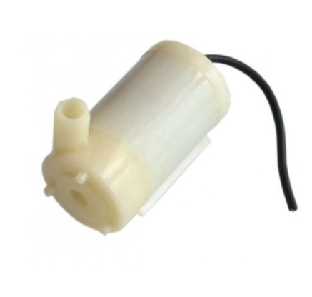


Water Pump
A small water pump used with Arduino is like
a little motor that can move water from one place
to another.
Imagine it as a mini water fountain or a
tiny water sprinkler. It works by spinning a small wheel
inside that pushes the water through a tube.
To make it work, you will need:
A small water pump - like the ones used in fish tanks or small fountains.
An Arduino - which is a small computer that controls the pump.
A relay or transistor - to control the power going to the pump.
Jumper Wires - to connect everything together.
A power source - like a battery or plug to power the pump.
Water Out
Water In
Red Wire
(Positive)
Black Wire
(Negative)

Slide 9
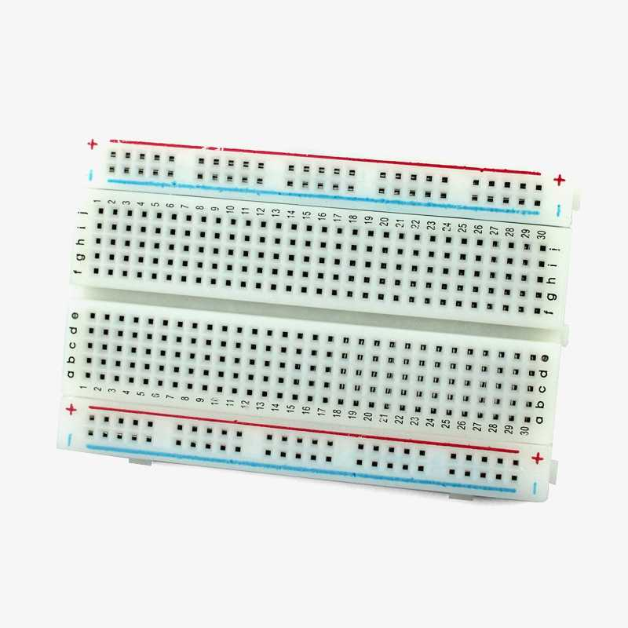
Bread Board
A breadboard is a tool used to build and test electronic circuits without needing to solder the components together. It's like a flat board where you can insert wires, resistors, sensors, and other parts to create a temporary circuit.
Preferable to connect
all GND in this slot and connect
another wire from here to GND
of Arduino
Preferable to connect
all VCC in this slot and connect
another wire from here to 5V
of Arduino

Slide 10
Series Connection
In a series connection on a breadboard, you connect parts in a straight line, like a train. The current has to go through each part one after the other.

Slide 11
Parallel Connection
In a parallel connection on a breadboard, you connect parts in different rows, like branches of a tree. Each part gets the same amount of current, and they all work together.

Slide 12
Series Connection

Slide 13
Parallel Connection

Slide 14
Connections
Arduino | Soil Moisture Sensor
A0 | A0
5V | VCC
GND | GND
D0 | --
Arduino | LCD- I2C
5V | VCC
GND | GND
A4(compulosory) | SCL
A5(compulosory) | SDA
Arduino | Relay Motor
5 | Signal
5V | VCC
GND | GND
Black wire (battery) | Black wire (Water Pump)
Red wire (battery) | C (Relay Motor)
Water Pump Red wire | N0 (Relay Motor)

Slide 15
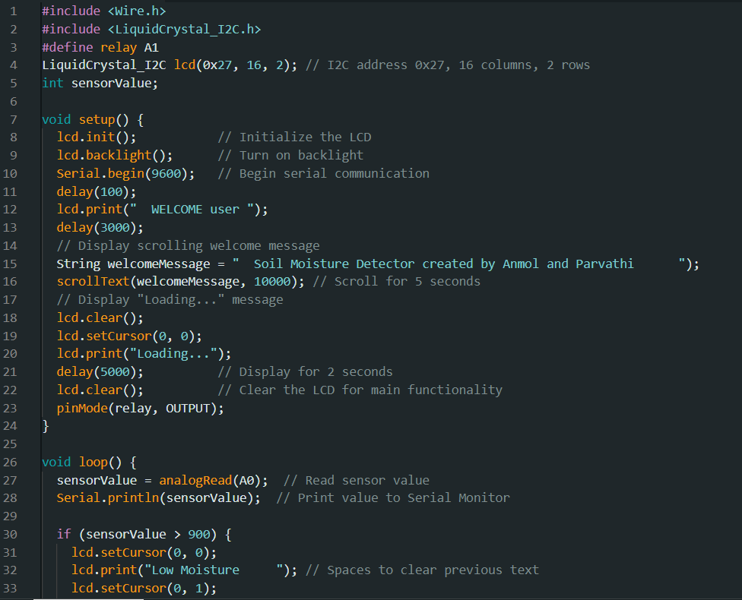
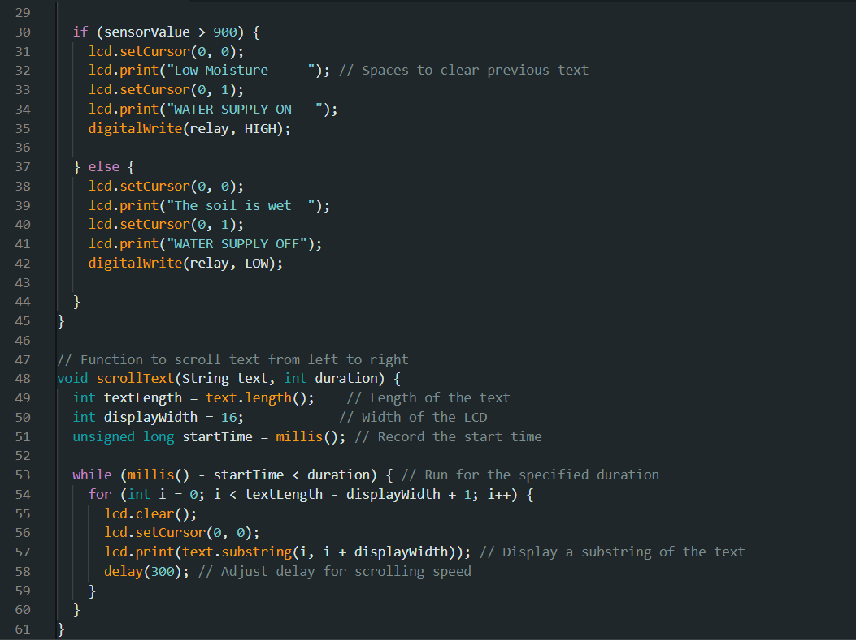
Code and explanation

Slide 16
#include: This tells the program to include external libraries that
provide additional functionality. Here, <Wire.h> allows communication
with I2C devices, and <LiquidCrystal_I2C.h> controls the LCD display
using the I2C protocol.
LiquidCrystal_I2C: This is a class for controlling an I2C-based LCD.
It simplifies the process of communicating with an LCD over the I2C bus.
The lcd object is created with the address 0x27 and a 16x2 display.
pinMode(relay, OUTPUT): Sets the relay pin (A1) to output mode.
This pin will control the relay to turn the water pump on or off based on soil moisture.
analogRead(A0): Reads the analog value from pin A0. This pin is connected
to a soil moisture sensor, and the function returns a value between 0 and 1023,
representing the moisture level.
Serial.begin(9600): Initializes serial communication with the computer, allowing
the program to send data (like sensor readings) to the Serial Monitor for debugging.
lcd.init(): Initializes the LCD screen for use.
lcd.backlight(): Turns on the backlight of the LCD to make the display visible.
lcd.setCursor(x, y): Moves the cursor to the specified position on the LCD
screen (x = column, y = row).
lcd.print(): Displays text on the LCD at the current cursor position.
digitalWrite(relay, HIGH): Turns on the relay by setting the relay pin to HIGH,
which could activate a connected device like a water pump.
digitalWrite(relay, LOW): Turns off the relay by setting the relay pin to LOW,
stopping the water pump.
millis(): Returns the number of milliseconds since the program started. This is used
to track time for the scrolling text function.
substring(): Extracts a part of a string (text) from a specified position. This is used to
scroll the text across the LCD.
delay(): Pauses the program for a specified number of milliseconds.
scrollText(String text, int duration): This function scrolls the given text across the
LCD for the specified duration. It moves a substring of the text across the screen one piece at a time.

